Slide 1

Sudoku Grid Reader
IMAGE PROCESSING
PROJECT
Doia Bogdan-Mihai
Group 30431

Slide 2
Project Description
The aim of the project is to process the image of an incomplete Sudoku grid using OpenCV library in C++.
Input: 9x9 Sudoku grid image
Output: The Sudoku grid represented on the computer
Objectives
Detect the lines that form the game
Bring the grid into the correct position
Divide the resulting image and detect the digits

Slide 3
Research
The project vastly employs the usage of the algorithms and code studied throughout the Image Processing classes. Other materials used were the papers and information provided by the teaching assistant, the OpenCV documentation and Stack Overflow.
General Approach
Apply several transformations to the image to reduce it to the main grid
Identify the main lines that form it
Change the perspective to be the standard one
Divide into 81 squares; identify for each square the digit present(or not) inside it
View a mock-grid based on the identified digits

Slide 4

Implementation Details

Slide 5
STEPS
Load image
Filter and binarize
Morphological operations
Warp the perspective
Find largest connected component
Detect lines
Find intersection points
Split and detect digits
Print the result

Slide 6
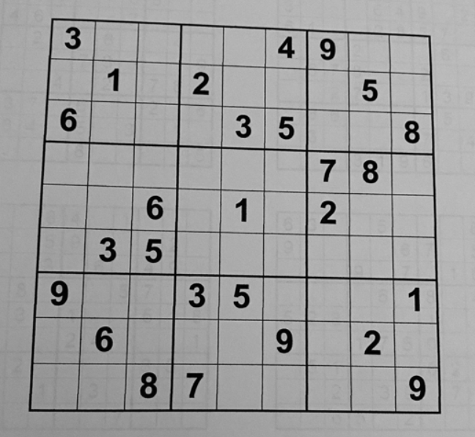
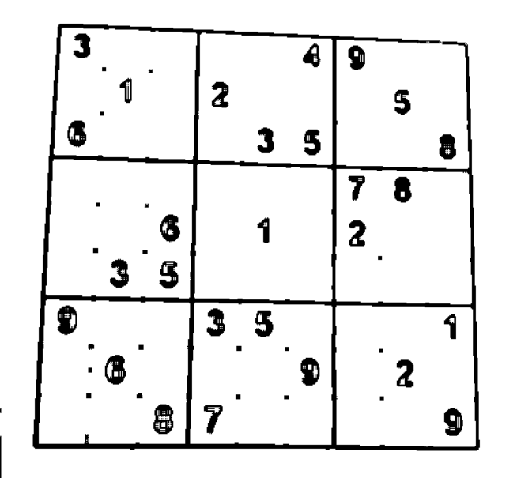
Filter & binarize. Morphological operations.
In C++ using the OpenCV library, blur the image by filtering, then binarize it with a hardcoded threshold to attempt to eliminate some of the noise in the image such as other words. Apply the morphological operations opening, erosion and apply set difference then inversion to prepare the image for better labeling.

Slide 7
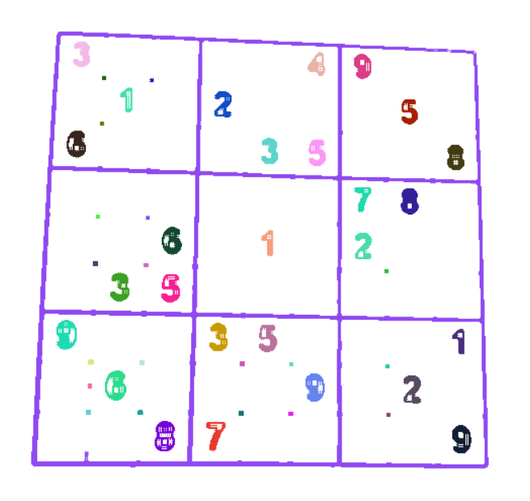
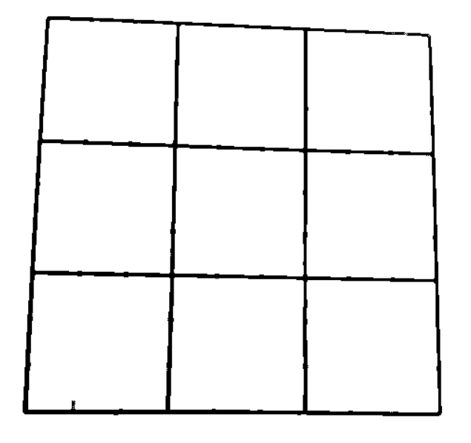
Labeling. Largest connected component.
Label the image from the previous step using the depth first search algorithm. Color the connected components in the image based on the labels given by DFS. Select the connected component with the most pixels. This should end up being the largest grid of the Sudoku, the exterior one and the 9 interior squares.

Slide 8
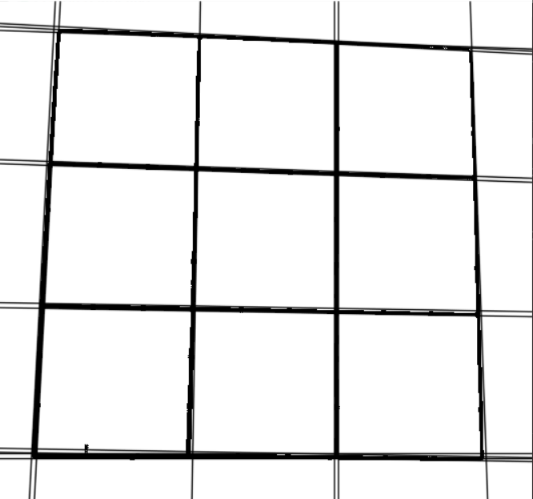
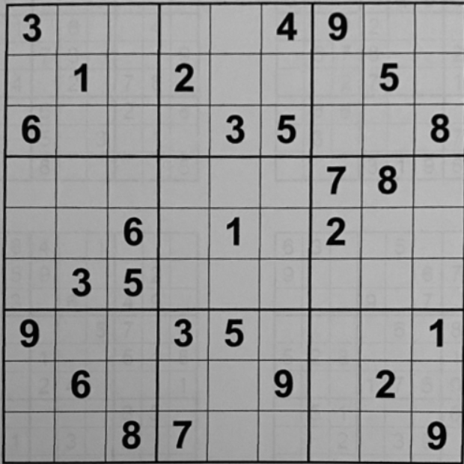
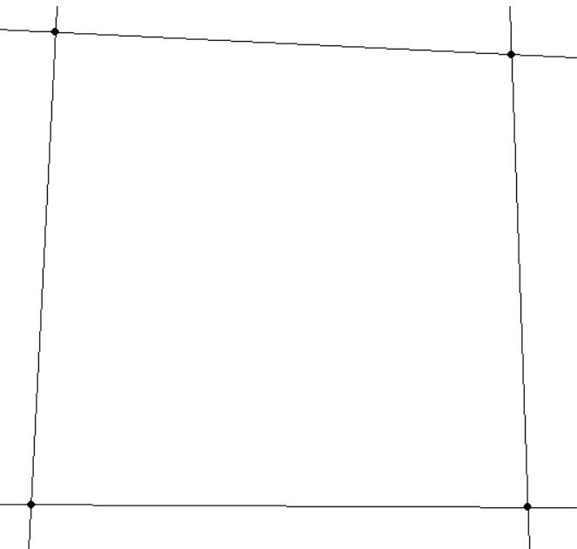
Detect lines. Find intersection points.
Using the Canny edge detection algorithm and the Hough transform, draw lines based on the edges of the previously found connected component. Iterate over the margins of the image to find the principal lines. Compute the intersection of those lines to get the 4 corners of the Sudoku. Based on the corners warp the perspective to see the image how it would be expected.

Slide 9
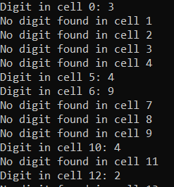
Split the image. Detect the digits.
Split the image into 81 equal squares (the Sudoku we work on is 9x9).
Using Python and Pytesseract, an optical character recognition tool read each of the 81 images and attempt to determine the digit present(or not) in it. Print the found digits to a simple .txt file

Slide 10
User Manual
Access the code on GitHub:
1
Install OpenCV and Python3
2
Modify thresholds or morphological operations as needed for input
3
Install tesseract: pip install tesseract. I used WLS and Ubuntu for commands
4
Add it to PATH: export PATH=$PATH:/usr/local/bin/tesseract
5
Run the OpenCV app to generate the images
6
Run the python script: python3 recognizedigits.py
7
Compile and run the C file to print the computed digits
8

Slide 11
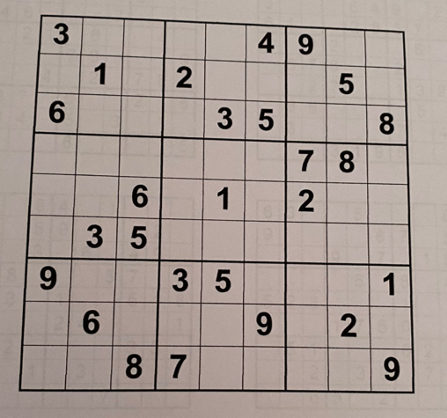
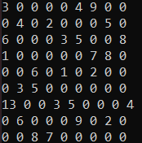
Results
Input photo of a Sudoku grid
Output of the detected digits

Slide 12
Conclusions
Despite not detecting every digit correctly, I am satisfied with the results of the project
It has proven to be very difficult to land on an implementation that would fit all inputs without modifying certain values
Developing the project involved many different tools, ranging from OpenCV to Python and Ubuntu and was a good occasion to work with all of them.

Slide 13
Bibliography
https://users.utcluj.ro/~robert/ip/ip.html
https://github.com/neeru1207/AI_Sudoku
https://docs.opencv.org/3.4/d9/db0/tutorial_hough_lines.html
https://pypi.org/project/pytesseract/
https://www.geeksforgeeks.org/perspective-transformation-python-opencv/
https://stackoverflow.com/questions/16524096/how-to-calculate-the-point-of-intersection-between-two-lines

